Slide 1

YMCA Customers
Heat Mapping & Analysis
Date: 04/14/2022
Client: YMCA Simcoe Muskoka

Slide 2

Project Goals
Generate a heat map of all YSM members, clients, and donors to see where overlaps and opportunities exists for the marketing group.
Review revenue/donations from various market sectors and suggest cross-selling opportunities to boost philanthropic donations.
Based on important findings, make recommendations about how to best execute action plans.

Slide 3

About the datasets
Information contained
Postal Codes of clients & donors
Camp Kitchi
Day Camp
Child Care
HFA (Health, Fitness, and Aquatics)
Philanthropy
Postal Codes of YMCA Child Care Facilities
Philanthropy Gift Information
Amount
Date
YMCA Campaign
Constituent Type (Individual & Organization)

Slide 4

Metadata
Data Source: YMCA Systems
Number of Records & Time Frame
Dataset | Number of records | Time Frame
Camp Kitchi | 729 | 2019
Day Camp | 915 | 2021
Child Care | 2099 | As of Jan 30, 2022
Waitlist for Child Care | 2717 | As of Jan 30, 2022
HFA | 93,672 | As of Jan 30, 2022
Philanthropy | 26,031 | 01/01/2016 - 06/30/2020

Slide 5
Business Questions
How many unique members, clients and donors are there and what are the similarities and differences between the groups in terms of their involvement with Health and Fitness, Child Care, Camp and Philanthropy?
Which product has the best chance to convert its customers to donors?
What is the revenue/donations and participation of the various marketing channels?
Where are the overlaps and areas of opportunity?
How does this data compare to economic statistics in the county of Simcoe Muskoka?

Slide 6
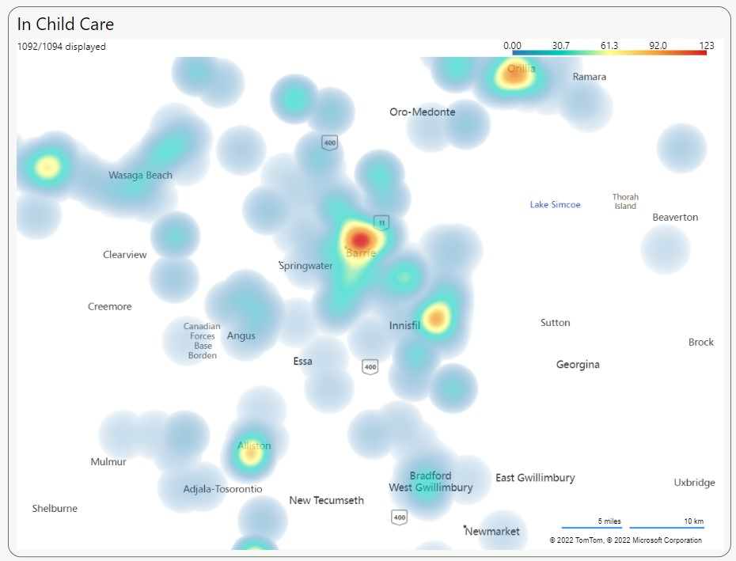
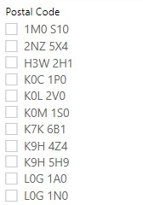
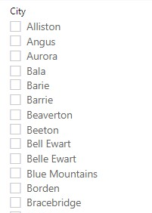
Heat Maps – Child Care clients
Metric:
Number of Customers by Postal Codes
Number of Facilities by Postal Codes
Insights:
The heat map indicates that clients prefer to enroll locally probably a function of closest distance to their home.
Not surprisingly, the child care clients are clustered around the locations of the centres.
This might depend on the customers’ behaviors since parents using Child Care services might not want to travel to far to get to the facilities.
Reporting Software: Microsoft Power BI

Slide 7
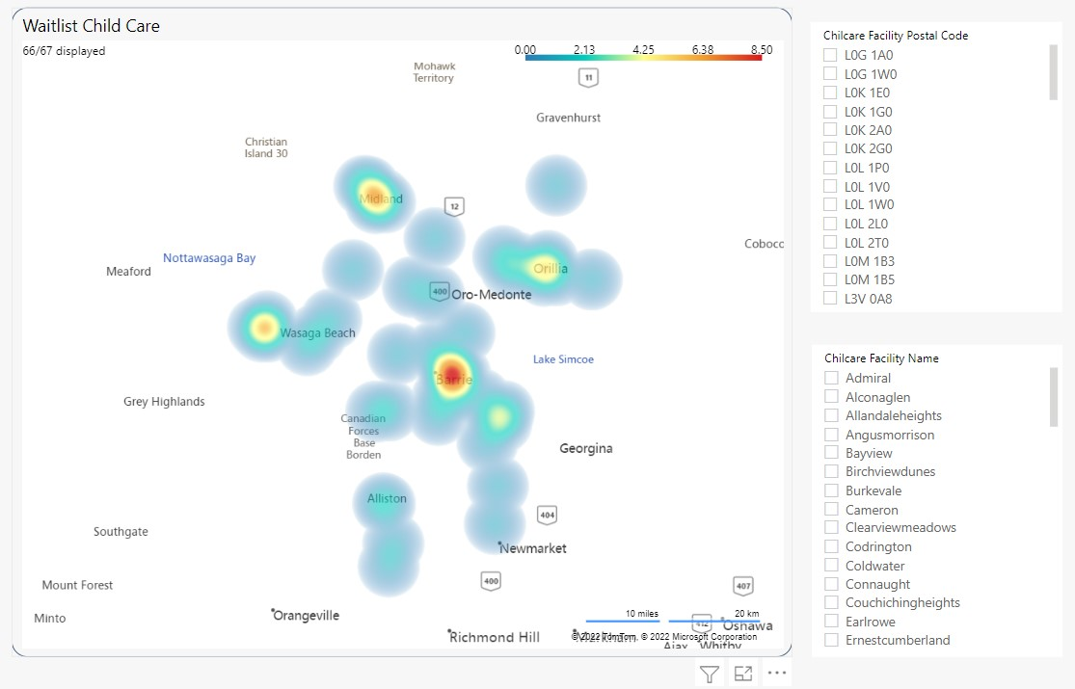
Heat Maps – Waitlist Child Care
Metric:
Number of Customers by Postal Codes
Number of Facilities by Postal Codes
Insights:
Not surprisingly, those child care participants shows a similar heat map to those children currently enrolled.
Location of the child care centre will attract clients closest to the centre to make dropping off and picking up easy as possible.
Reporting Software: Microsoft Power BI

Slide 8
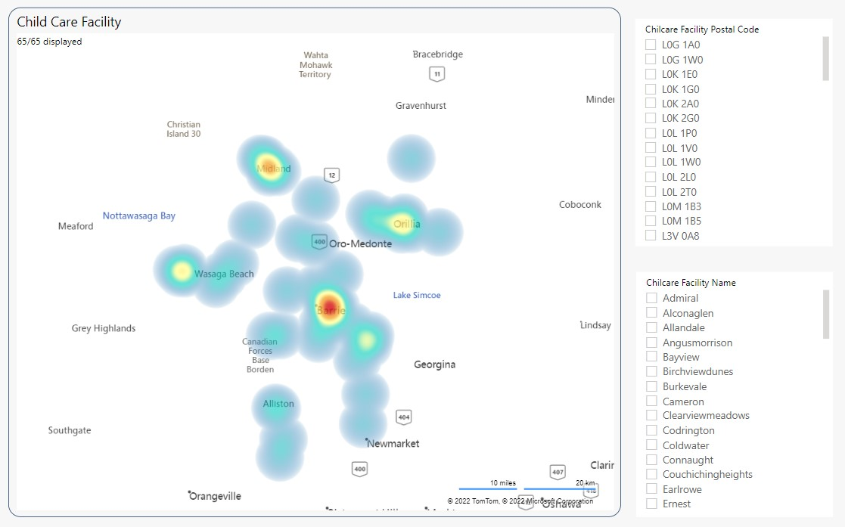
Heat Maps – Child Care Facility
Metric:
Number of Customers by Postal Codes
Number of Facilities by Postal Codes
Insights:
The customers’ locations are distributed the same way as the locations of YMCA facilities
This shows that YMCA mostly attracts customers “locally”
This might depend on the customers’ behaviors since parents using Child Care services might not want to travel to far to get to the facilities.
Reporting Software: Microsoft Power BI

Slide 9
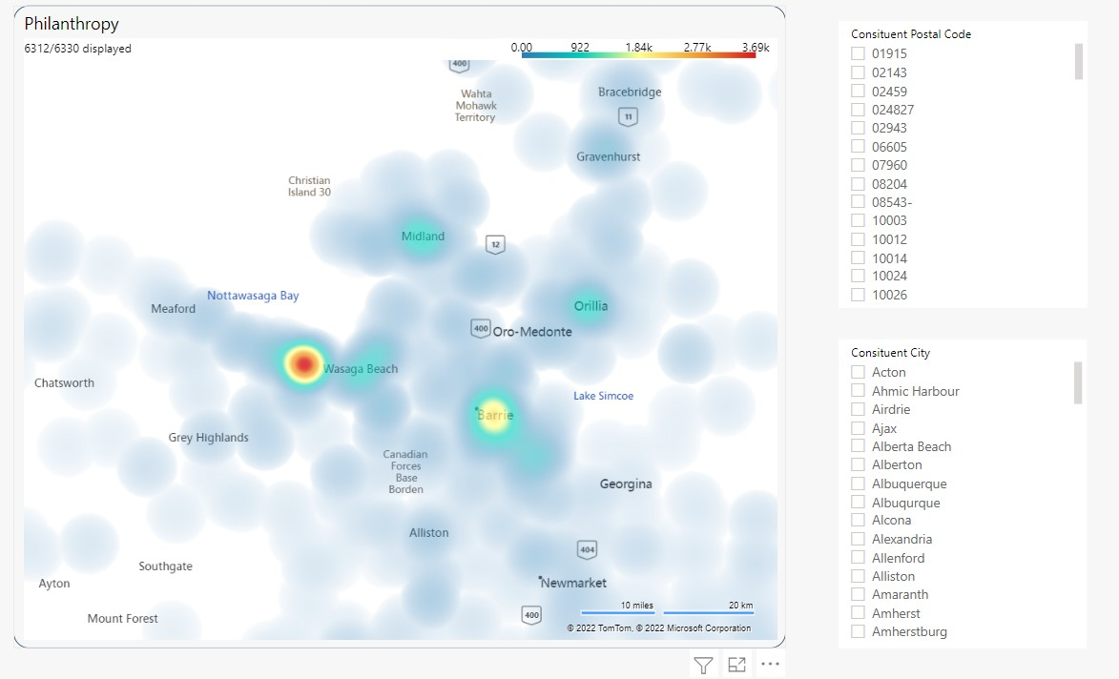
Heat Maps – Philanthropy
Metric:
Number of Customers by Postal Codes
Insights:
Larger number of Donors are in Wasaga Beach compared to Barrie area.
Reporting Software: Microsoft Power BI

Slide 10
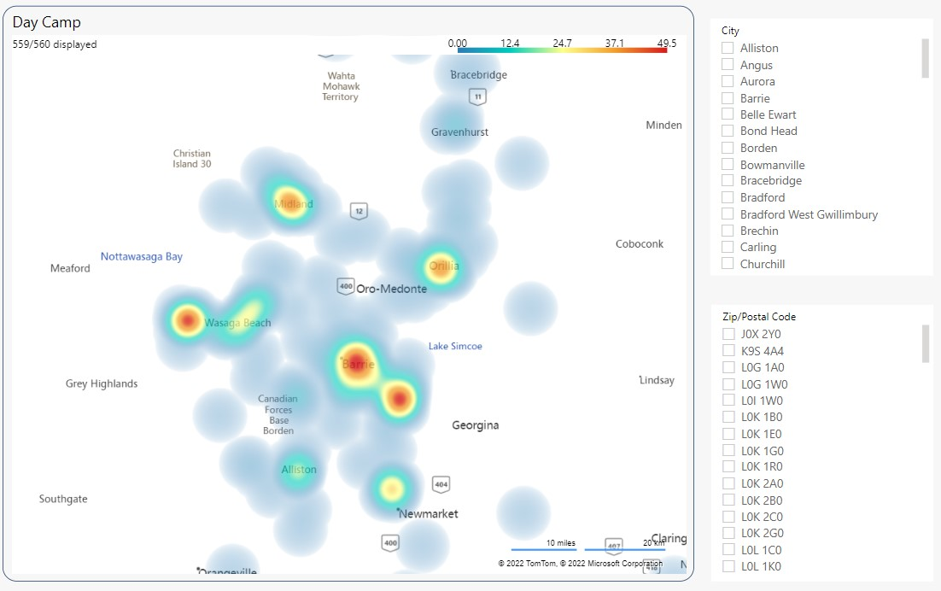
Heat Maps – Day Camp
Metric:
Number of Customers by Postal Codes
Insights:
Day Camp & HFA have similar customers location distribution.
Since day camps operate out of the HFA centres , it would make sense that the campers are clustered around the centres.
Reporting Software: Microsoft Power BI

Slide 11
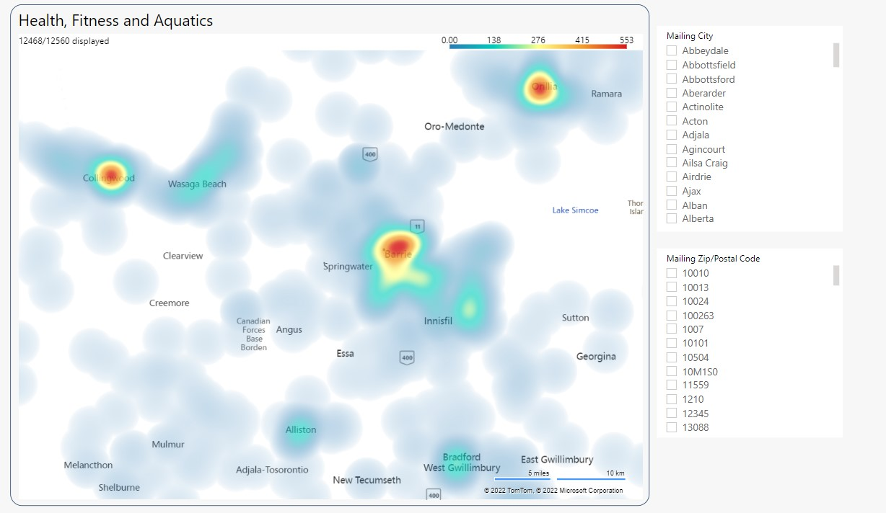
Heat Maps – Health, Fitness, and Aquatics
Metric:
Number of Customers by Postal Codes
Insights:
Day Camp & HFA have similar customers location distribution
Location seems to be the determining factor for HFA members.
Members are close to the location of the centres.
Reporting Software: Microsoft Power BI

Slide 12
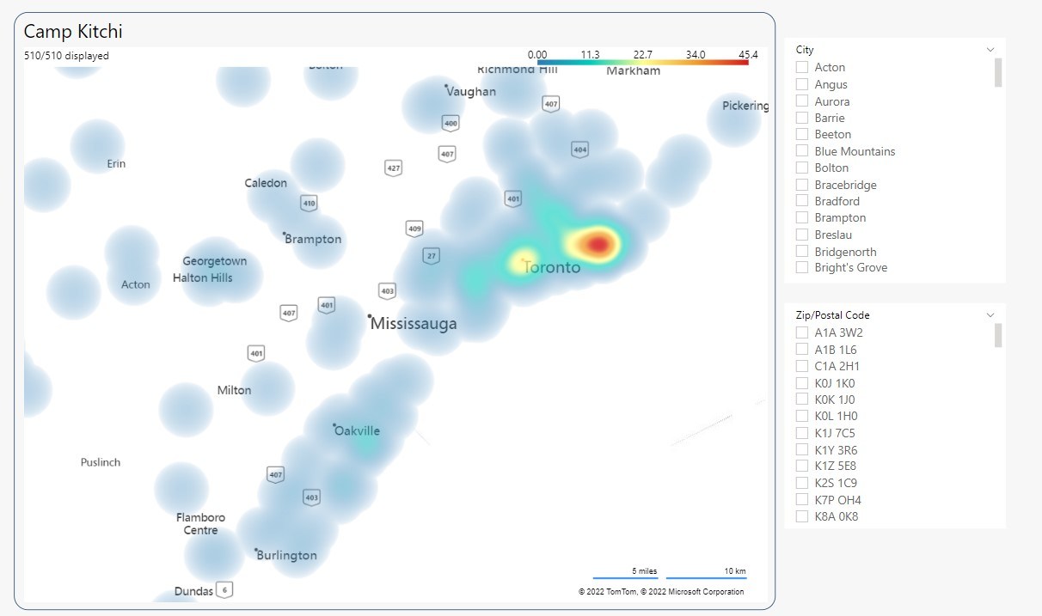
Heat Maps – Camp Kitchi
Metric:
Number of Customers by Postal Codes
Insights:
Most Kitchi Camp’s customers are based in the Greater Toronto Area.
Interestingly, Camp Kitchi participants are coming from the GTA so marketing of Camp Kitchi should be marketed outside of Simcoe County.
Reporting Software: Microsoft Power BI

Slide 13
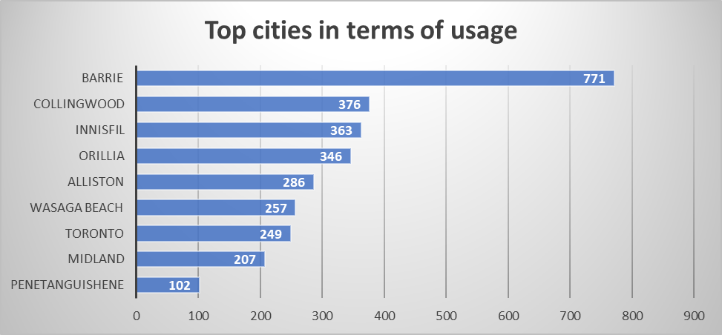
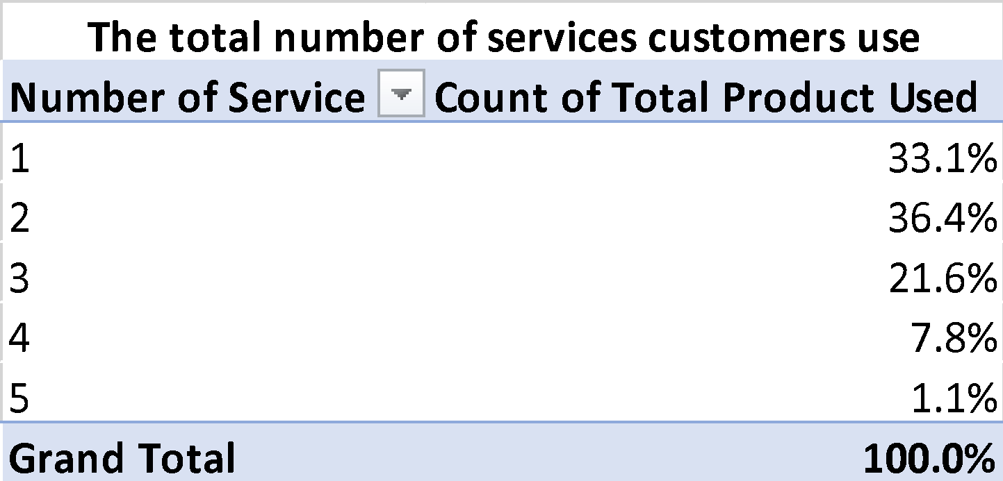
Market Basket Analysis
Metric:
Total Product Used by Postal Codes
Top Cities in terms of usage by Postal Codes
Insights:
Barrie, Collingwood and Innisfil are among the top three cities that use the greatest number of products
One-third of the customers use only a single product.
Only a mere 1% of the total customers use all five products.
There is opportunity for marketing to promote multiple services to clients since 58% of clients purchase two and three services.
Reporting Software: Microsoft Excel

Slide 14
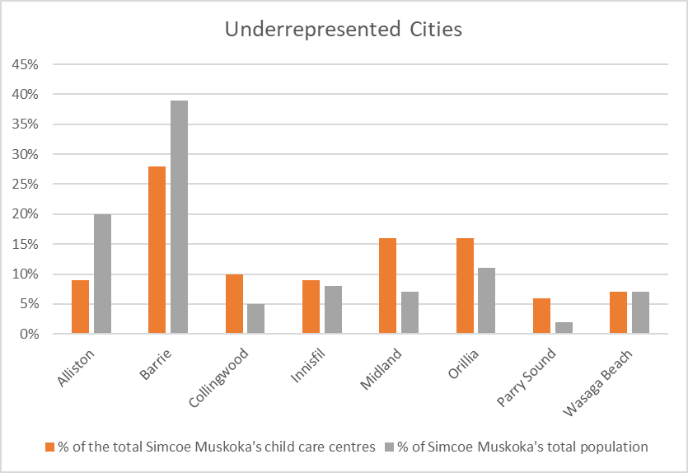

Underrepresented cities in terms of CC centers
Insight:
The cities Alliston and Barrie are the among the most underrepresented cities in terms of childcare centres.
There is a huge opportunity to expand childcare centres particularly in South Simcoe.
With the advent of government supported $10 per day childcare the need for space is even more important to capitalize on the revenue opportunities.

Slide 15
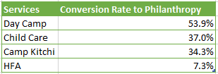
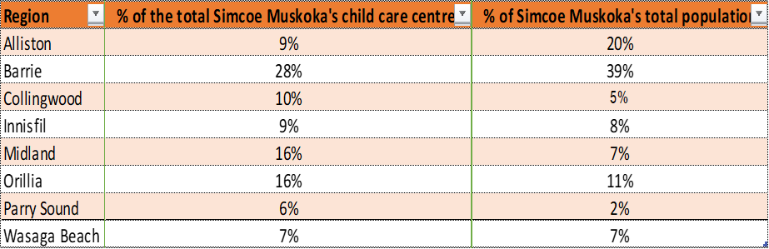
Key Insights
Customers - Donors Conversion
The results of different forecasting techniques confirmed that the Day Camp channel has the highest conversion rate (close to 54%) in terms of converting the customers to donors and hence YMCA should spend its bulk of resources to this process.
Expanding Facilities
Based on the population statistics of Simcoe Muskoka regions, most of the areas have enough Child Care centres baring two cities namely - Alliston and Barrie.
Only 9% of the total centres are allocated to Alliston area which covers 20% of the Simcoe Muskoka’s total population and Barrie which covers one-third of Simcoe Muskoka’s total population has only 19 centres. And, hence, necessary steps must be taken to build enough centres for these underrepresented cities.

Slide 16
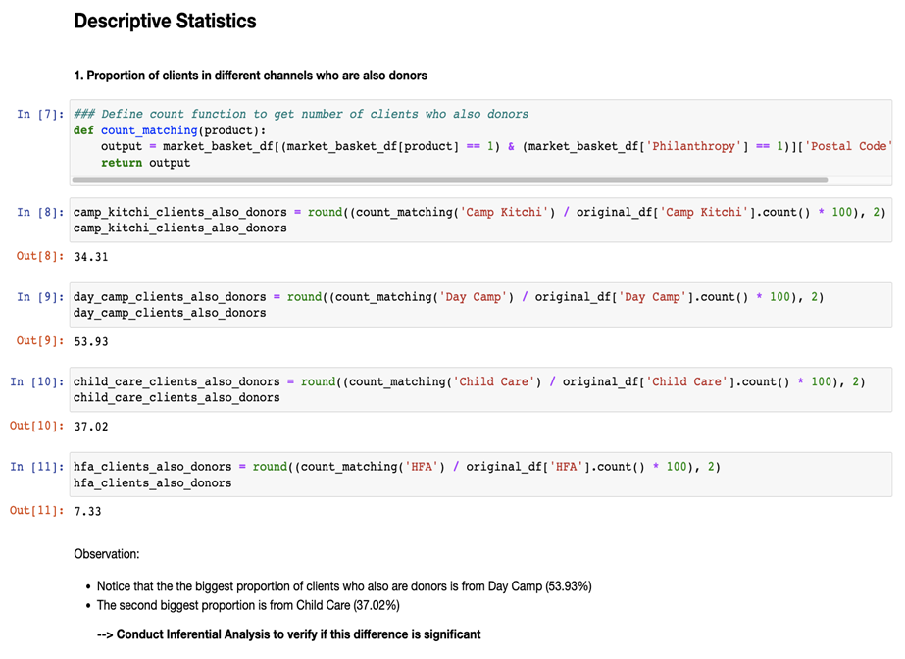
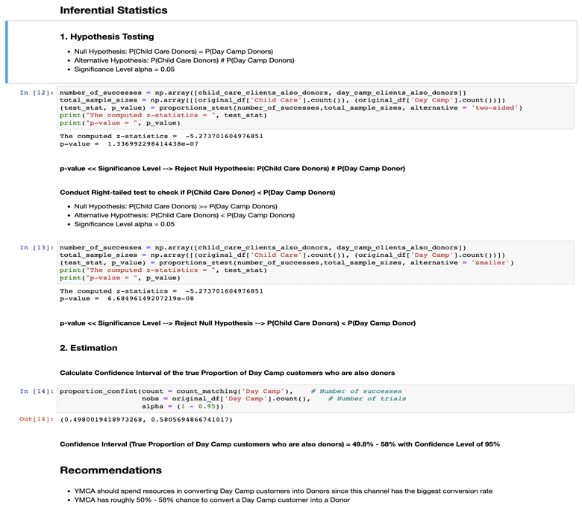
Appendix
Statistical Programming Language: Python
Data Science Software: Jupyter Notebook

Slide 17
Appendix
Statistical Test:
Context: Results from Descriptive Statistics show that:
The biggest proportion of clients who also are donors is from Day Camp (53.9%)
The second biggest proportion is from Child Care (37.0%)
The third biggest proportion is from Camp Kitchi (34.3%)
Insights:
YMCA should spend resources in converting Day Camp customers into Donors since the channel has the biggest conversion rate.
Interval Estimation: YMCA has roughly 50% - 58% chance to convert a Day Camp customer into a Donor.

Slide 18

Thank you

